Slide 1
PC Programming & Booting
Yubin Xia

Slide 2
Our Tools
References
http://pdos.csail.mit.edu/6.828/2012/xv6.html
Both the code and book
http://wiki.osdev.org
IA-32 Intel Architecture Software Developer's Manuals
Volume 3A: System Programming Guide, Part 1
Volume 3B: System Programming Guide, Part 2

Slide 3
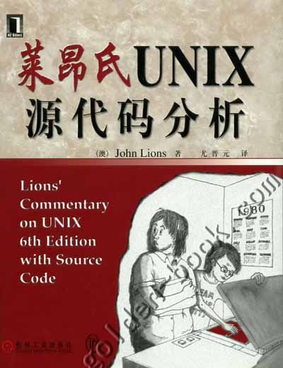
Once upon a time …
Lion’s commentary
Based on UNIX v6
Which is not on x86
But PDP-11
Xv6
Unix v6
For x86!
Runnable!

Slide 4
Outline
PC Architecture
Memory
Execution
PC Emulation
Notes:
Big ideas: data can be instructions, stack, hardware == software

Slide 5
PC Architecture
Memory
Execution
PC Emulation
Notes:
Big ideas: data can be instructions, stack, hardware == software

Slide 6
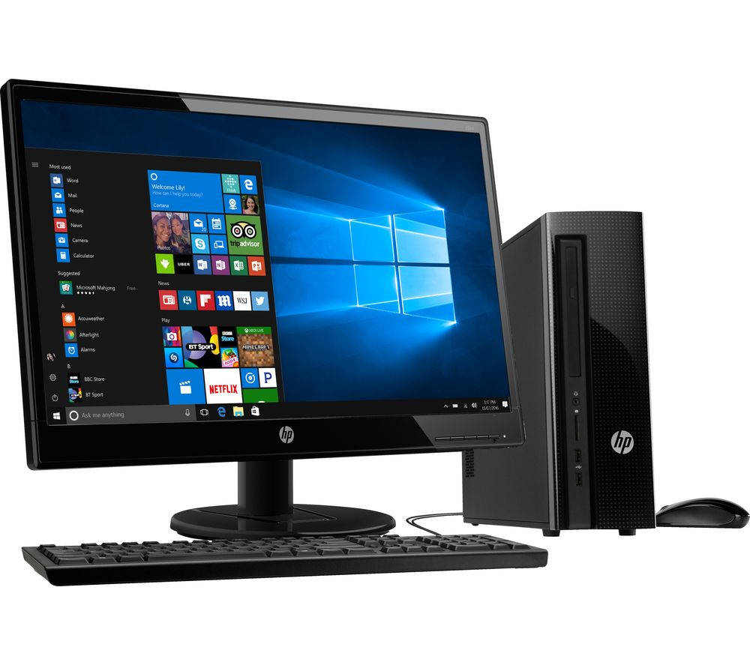
A PC
How to make it to do something useful?

Slide 7
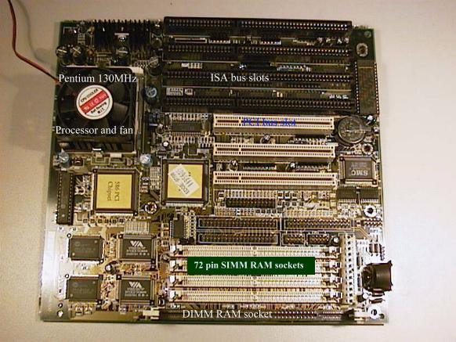
PC board
Notes:
CPU, address and data signals, memory, disk, keyboard, display, BIOS ROM, clock, …

Slide 8
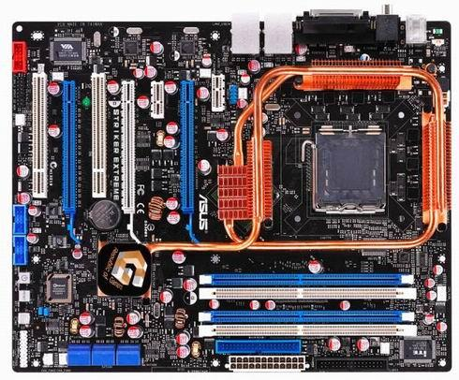
PC board - Nowadays
Notes:
CPU, address and data signals, memory, disk, keyboard, display, BIOS ROM, clock, …

Slide 9
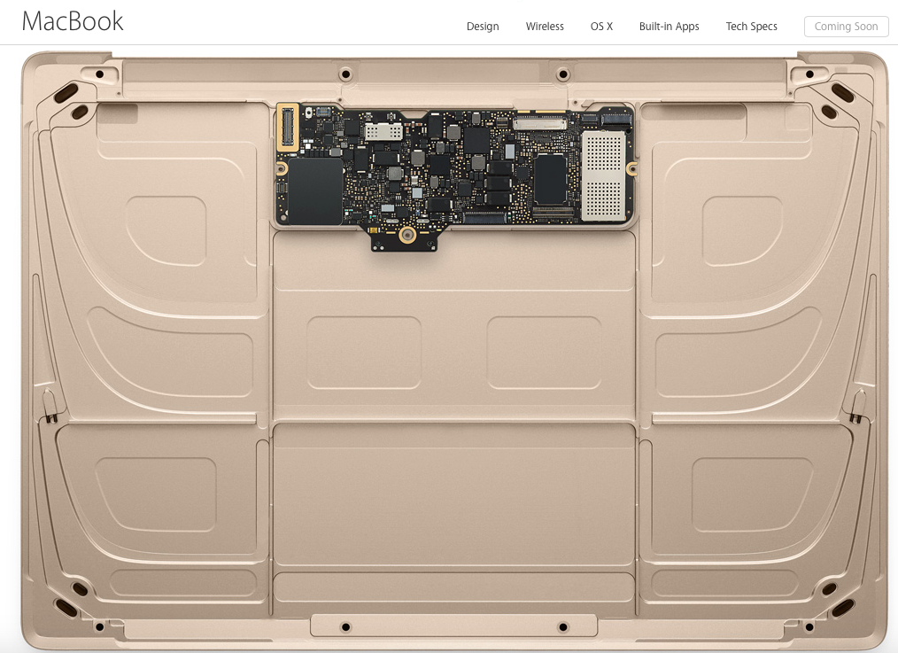
Macbook inside

Slide 10
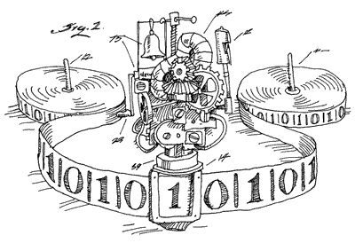
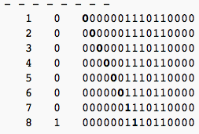
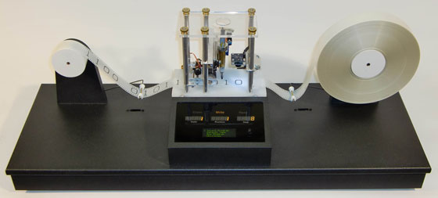
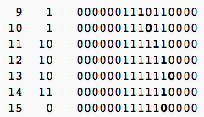
The Turing Machine
Calculate 3+2: 0000001110110000

Slide 11
The von Neumann Model
Central
Processing
Unit
Input/ Output
Main
Memory
I/O: communicating data to and from devices
CPU: digital logic for performing computation
Memory: N words of B bits

Slide 12
The Stored Program Computer
Main memory
CPU
instruction
instruction
for (;;) {
next instruction
}
instruction
…
data
data
data
CPU interpreter of instructions
Memory holds instructions and data

Slide 13

x86 Implementation (32-bit)
instruction
2³²-1
instruction
instruction
…
data
data
data
0
EIP is incremented after each instruction
Instructions are different length
EIP modified by CALL, RET, JMP, and cond. JMP

Slide 14
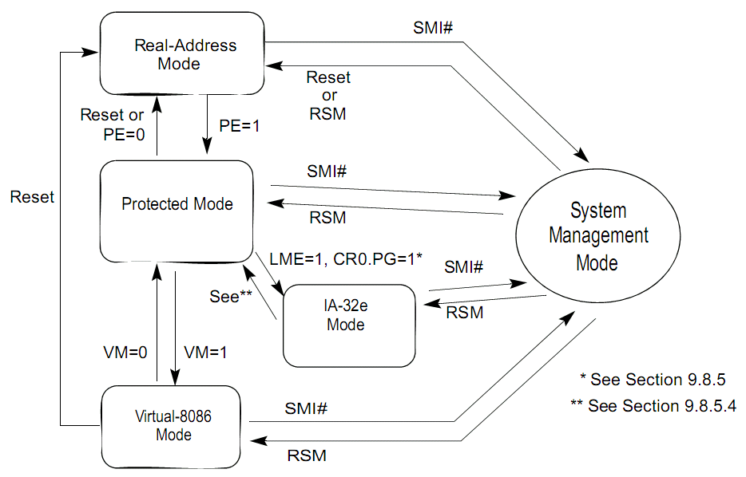
System Architecture Overview
Volume 3A: System Programming Guide, Part 1
2.1~2.5
Modes
Real Mode
Protected Mode

Slide 15
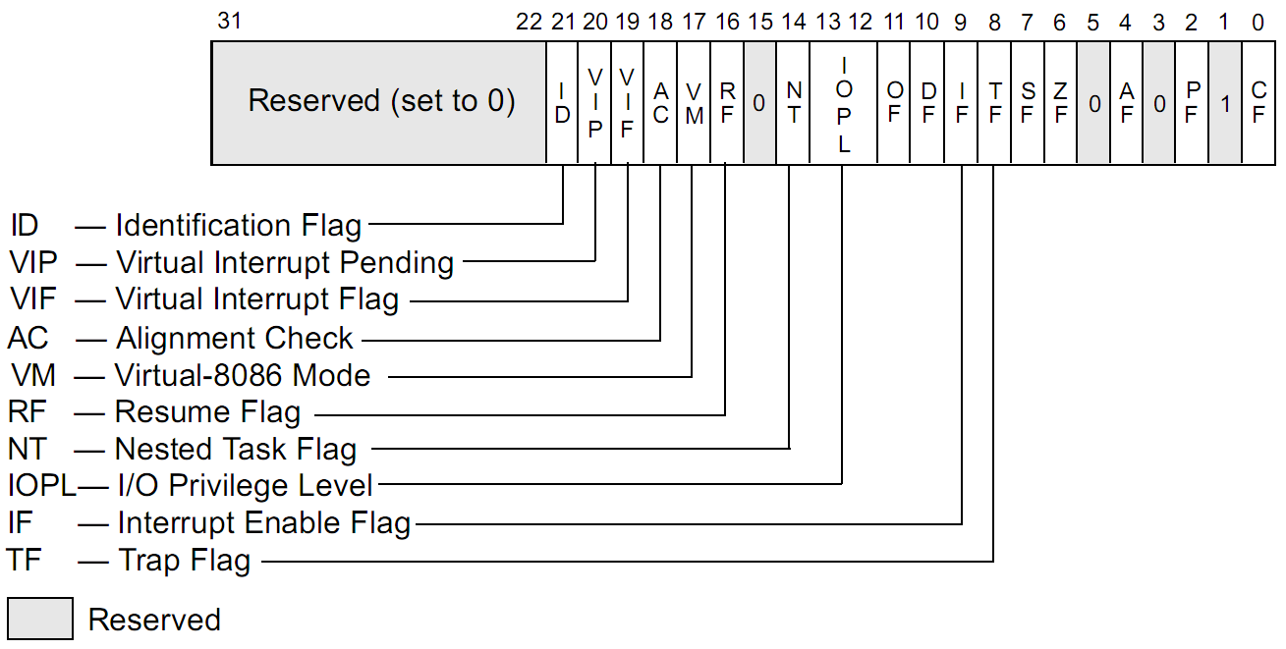
System Architecture Overview
System Flags in the EFLAGS

Slide 16
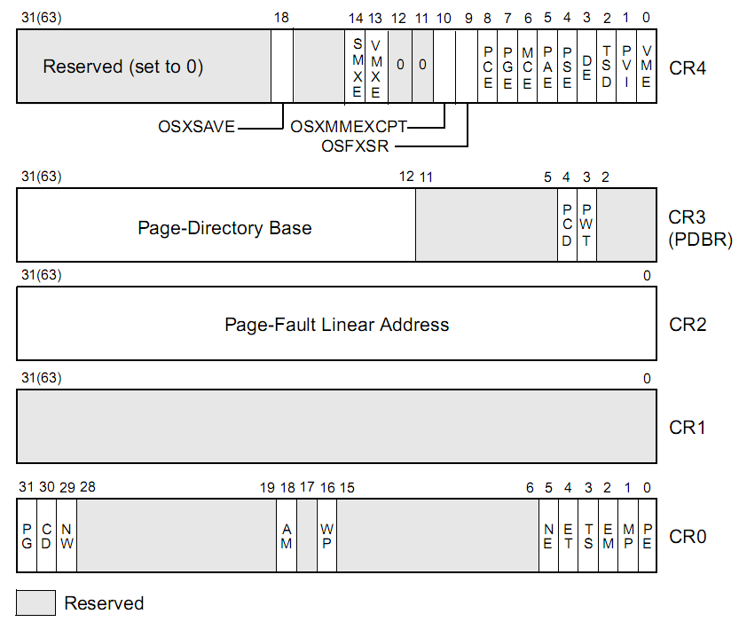
System Architecture Overview
Control Registers
PG: Paging
PE: Protection

Slide 17
System Architecture Overview
Memory-Management Registers
GDTR (Global Descriptor Table Register)
Base Address, Limit …
IDTR (Interrupt Descriptor Table Register)
Handler Address, Ring Level …
TR (Task Register)
TSS

Slide 18
PC Architecture
Memory
Execution
PC Emulation
Notes:
Big ideas: data can be instructions, stack, hardware == software

Slide 19
Memory Model
8086: 16-bits microprocessor
Real Mode: physical addr = 16 * segment + offset
Space: 64KB
External address to 20-bits
Space: 1MB
The extra 4 bits come from segment registers
CS: code segment, for EIP
SS: stack segment, for SP and BP
DS: data segment for load/store via other registers
ES: another data segment, destination for string ops
e.g. CS=f000 IP=fff0 => ADDR: ffff0

Slide 20
Memory Model
80386: 32-bit data and bus addresses
Protected Mode
Now: the transition to 64-bit addresses
Backwards compatibility:
Boots in 16-bit real mode, and switches to 32-bit protected mode
See: “boot/boot.S”

Slide 21
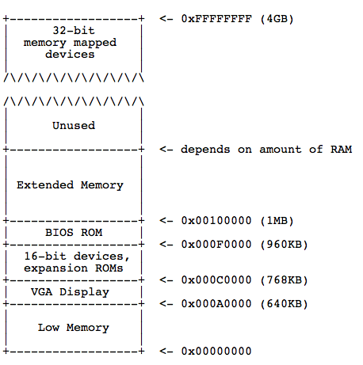
Physical Address Space Layout

Slide 22
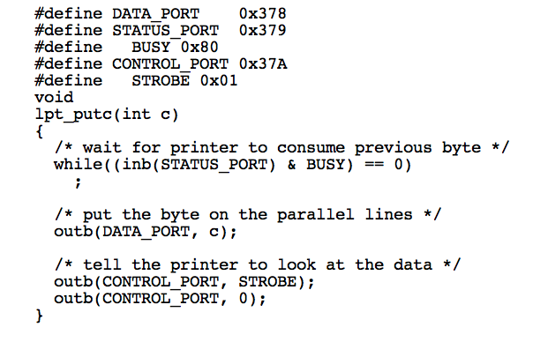
I/O space and instructions
static __inline uint8_t inb(int port)
{
uint8_t data;
__asm __volatile("inb %w1,%0"
: "=a" (data) : "d" (port));
return data;
}
static __inline void
outb(int port, uint8_t data)
{
__asm __volatile("outb %0,%w1"
: : "a" (data), "d" (port));
}

Slide 23
Memory-mapped I/O
Use normal addresses
No need for special instructions
No 1024 limit
System controller routes to device
Works like “magic” Memory
Addressed and accessed like memory
But does not behave like memory
Reads and writes have “side effects”
Read result can change due to external events
Recall: the “volatile” keyword

Slide 24
PC Architecture
Memory
Execution
PC Emulation
Notes:
Big ideas: data can be instructions, stack, hardware == software

Slide 25
XV6 Booting code

Slide 26
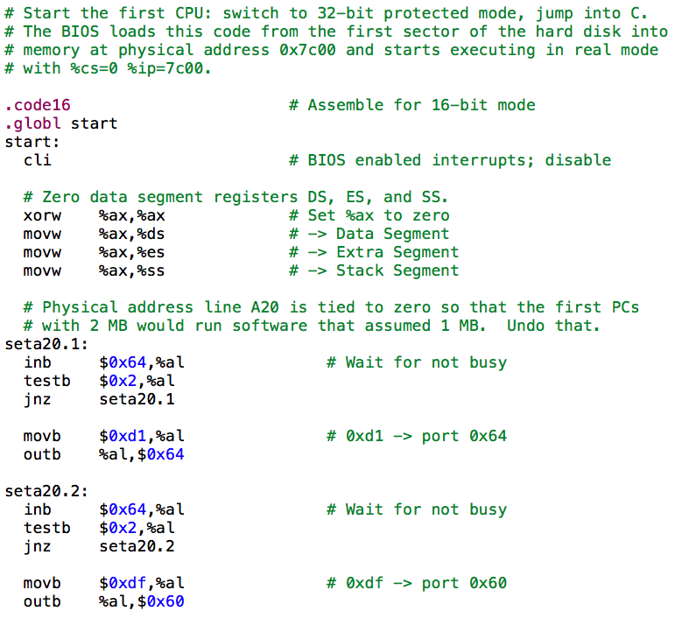
Notes:
A20: http://blog.csdn.net/ruyanhai/article/details/7181842

Slide 27
A20 Line
(https://wiki.osdev.org/A20_Line)
The A20 Address Line is the physical representation of the 21st bit (number 20, counting from 0) of any memory access. When the IBM-AT (Intel 286) was introduced, it was able to access up to sixteen megabytes of memory (instead of the 1 MByte of the 8086). But to remain compatible with the 8086, a quirk in the 8086 architecture (memory wraparound) had to be duplicated in the AT. To achieve this, the A20 line on the address bus was disabled by default.
The wraparound was caused by the fact the 8086 could only access 1 megabyte of memory, but because of the segmented memory model it could effectively address up to 1 megabyte and 64 kilobytes (minus 16 bytes). Because there are 20 address lines on the 8086 (A0 through A19), any address above the 1 megabyte mark wraps around to zero. For some reason a few short-sighted programmers decided to write programs that actually used this wraparound (rather than directly addressing the memory at its normal location at the bottom of memory). Therefore in order to support these 8086-era programs on the new processors, this wraparound had to be emulated on the IBM AT and its compatibles; this was originally achieved by way of a latch that by default set the A20 line to zero. Later the 486 added the logic into the processor and introduced the A20M pin to control it.
For an operating system developer this means the A20 line has to be enabled so that all memory can be accessed. This started off as a simple hack but as simpler methods were added to do it, it became harder to program code that would definitely enable it and even harder to program code that would definitely disable it.
The traditional method for A20 line enabling is to directly probe the keyboard controller. The reason for this is that Intel's 8042 keyboard controller had a spare pin which they decided to route the A20 line through. This seems foolish now given their unrelated nature, but at the time computers weren't quite so standardized. Keyboard controllers are usually derivatives of the 8042 chip. By programming that chip accurately, you can either enable or disable bit #20 on the address bus.
When your PC boots, the A20 gate is always disabled, but some BIOSes do enable it for you, as do some high-memory managers (HIMEM.SYS) or bootloaders (GRUB).

Slide 28
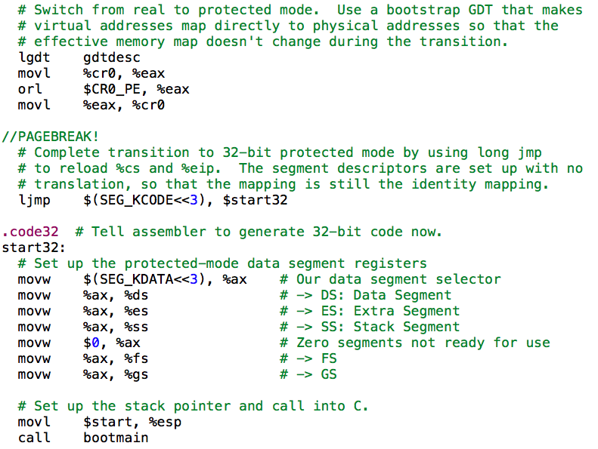

Slide 29
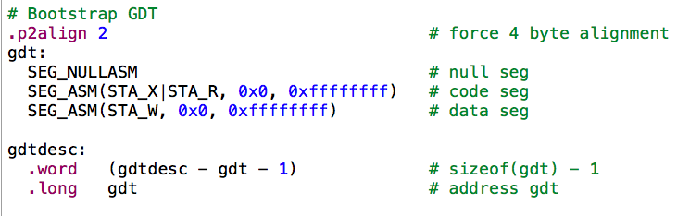
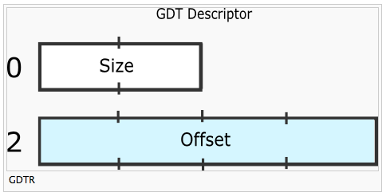
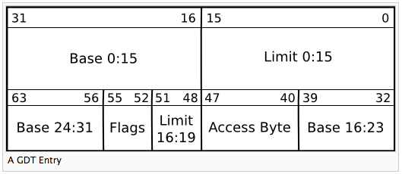
http://wiki.osdev.org/Global_Descriptor_Table
https://wiki.osdev.org/GDT_Tutorial

Slide 30
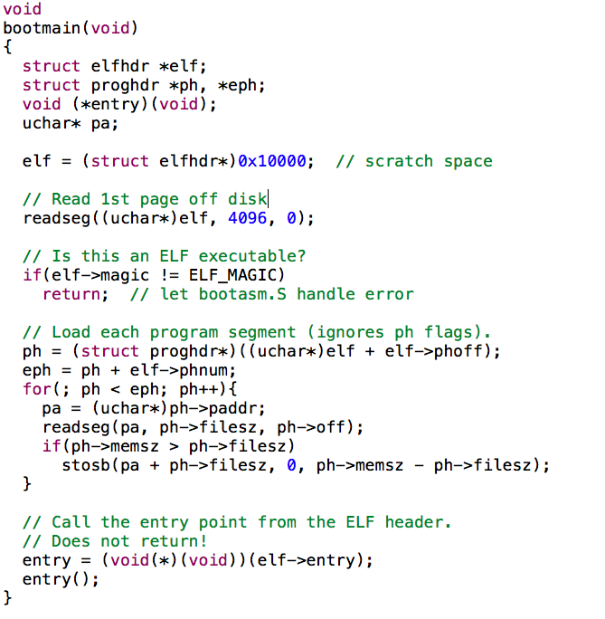

Slide 31
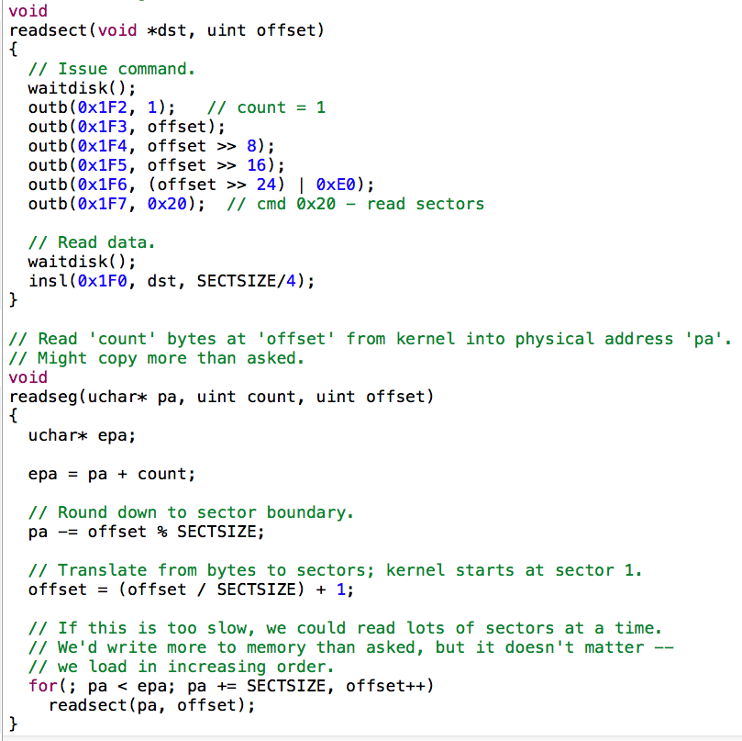

Slide 32
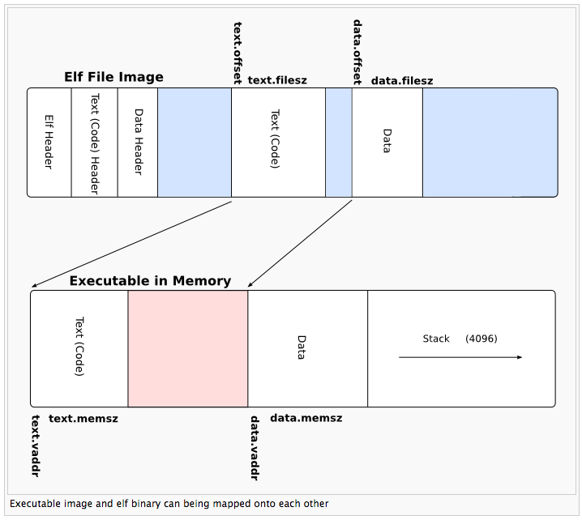

Slide 33
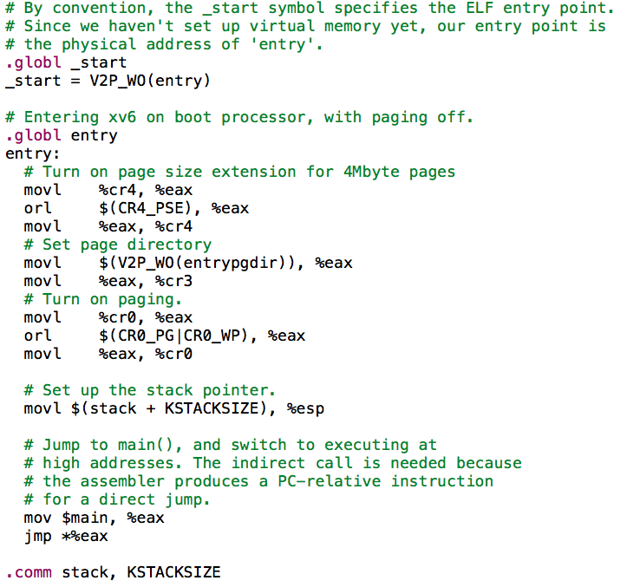

Slide 34
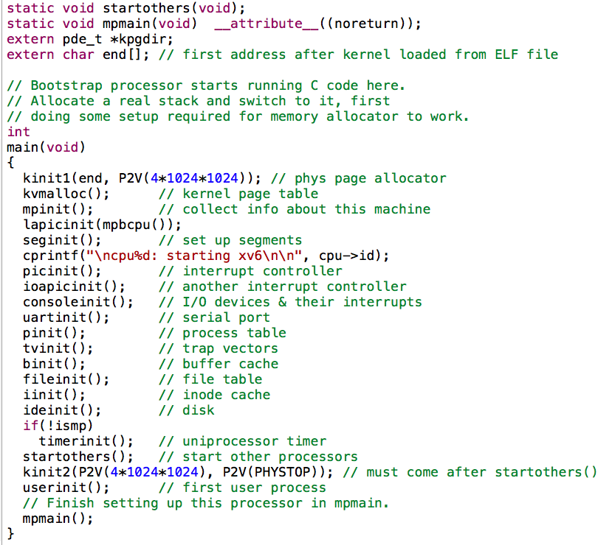

Slide 35
PC Architecture
Memory
Execution
PC Emulation
Notes:
Big ideas: data can be instructions, stack, hardware == software

Slide 36
Development using PC emulator
Bochs PC emulator
Does what a real PC does
Only implemented in software!
JOS
Runs like a normal program on “host” operating system
PC emulator
Linux
PC
http://bochs.sourceforge.net/

Slide 37
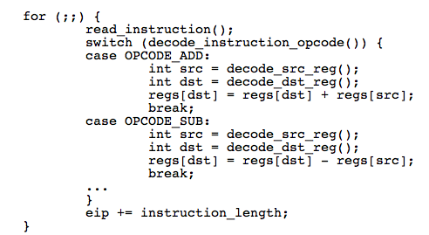
Emulation of CPU
OPCODE_ADD

Slide 38
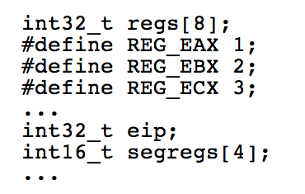

Emulation of Memory

Slide 39
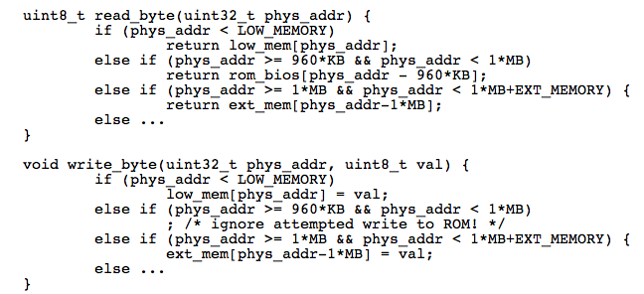
Emulation of x86 Memory
Low Memory
Extended Memory

Slide 40
Emulation of Devices
Hard disk: using a file of the host
VGA display: draw in a host window
Keyboard: host’s keyboard API
Clock chip: host’s clock
Etc.

Slide 41
Why Emulator
OS Test and Debug
Increase Utilization
Just as Why IBM’s Virtualization
IBM’s M44/44X, in 1960s
Notes:
41

Slide 42
Thanks
Next time:
Intro to PC booting & OS structure

Slide 43
Homework
What is the difference between user-level ISA and system-level ISA?
What is memory addressing mode? How many modes are there (please describe them)? Why not just use one?
Use your own word (and figures, if you want) to describe the process from power-on to BIOS end (just before kernel starts)
What is the usage of "ljmp $(SEG_KCODE<<3), $start32"?
What do you learn from the A20 problem?

